Slide 1



Netflix: Business Overview

Slide 2
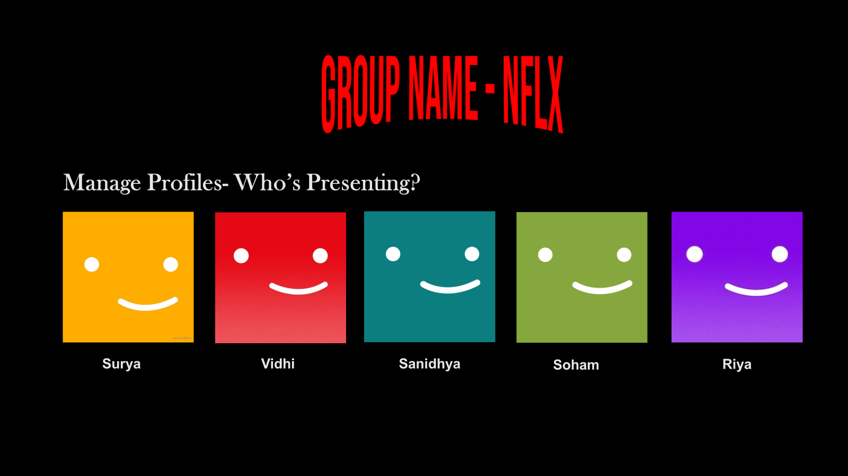

Thank you for your time and attention 🙂
Who’s Presenting?
Vidhi
Sanidhya
Soham
Surya
Riya

Slide 3
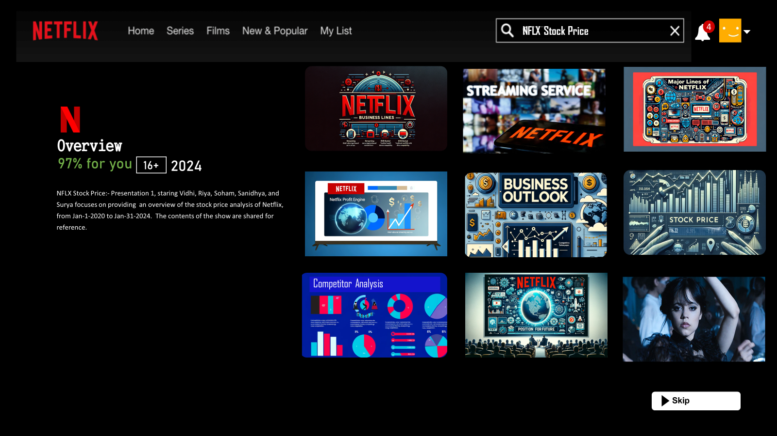
Netflix: Business Overview
This presentation provides an overview of Netflix's business, including its services, major business lines, profit engine, business outlook, and stock price analysis.

Slide 4
Netflix: A Leader in Entertainment
Netflix, Inc. is a prominent player in the global entertainment industry
Known for its subscription-based streaming service offering a vast library of films and television series
Includes both licensed content and original productions

Slide 5


Netflix's Services
Netflix provides a streaming service that allows its subscribers to watch a wide variety of award-winning TV shows, movies, documentaries, and more!
Available on thousands of internet-connected devices
No commercials and flat monthly fee

Slide 6

Profit Engine
The streaming segment, particularly the international streaming service, is Netflix's profit engine.
Netflix's global subscribers now exceed U.S. numbers, driven by expansion to 190+ countries and localized content.
Investment in original content boosts subscriber growth and retention, cementing Netflix's streaming leadership.

Slide 7
Business Outlook
Competition Intensifies:
New entrants like Disney+, Amazon, Apple TV+
Potential impact on subscriber growth and content costs.
Market Saturation:
Slowed subscriber growth
International markets become essential for future expansion
Content Investment:
Focus on investing in original content
High expenses with continuous capital requirements.
Regulatory and Economic Factors:
Consideration of regulations and economic conditions

Slide 8

Netflix's Position for the Future
Strong brand, extensive content library, and global reach
Adaptation to changing consumer preferences and technological advancements is key to sustaining growth and profitability

Slide 9
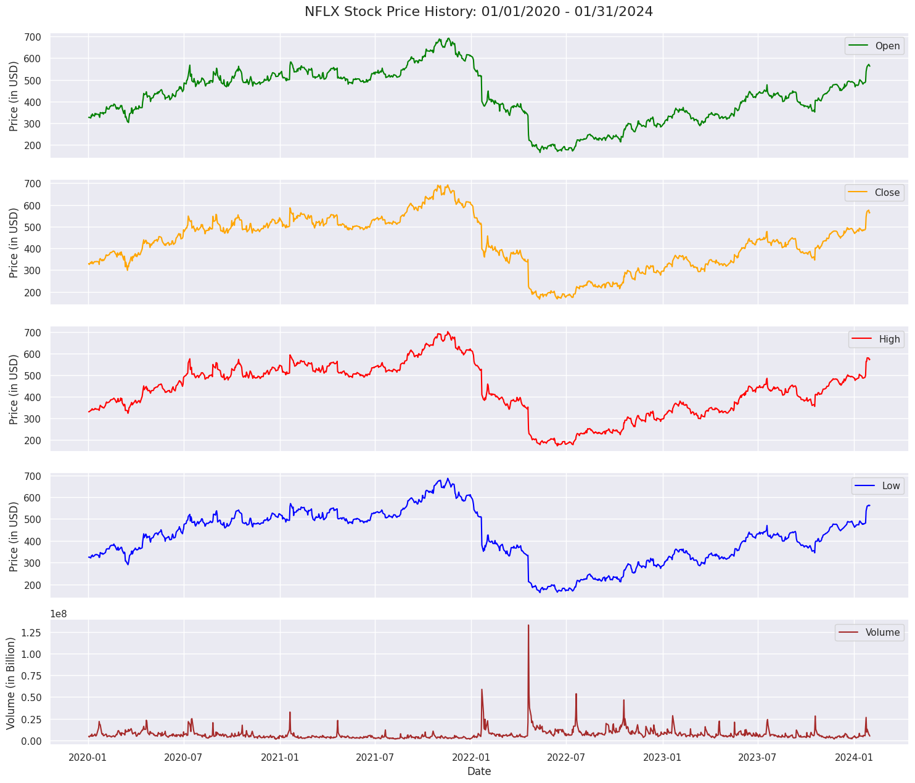

Netflix’s Stock Price History - Jan 1, 2020 to Jan 31, 2024
This visualization captures the stock's open, close, high, low, and volume, offering a detailed glimpse into the market's response to company milestones, global events, and industry trends.

Slide 10
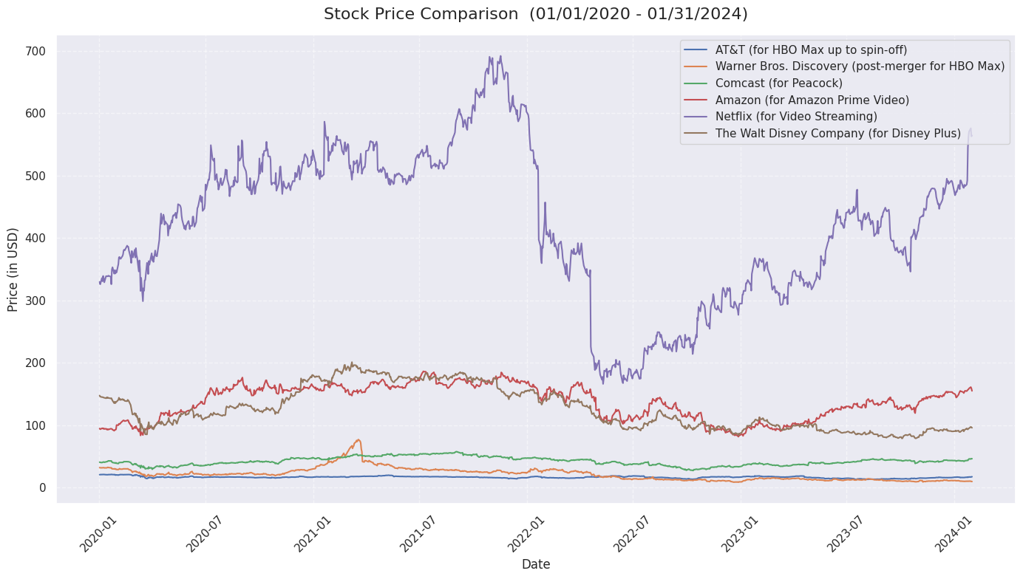





Competitor’s Stock Price History - Jan 1, 2020 to Jan 31, 2024
Competitors of Netflix:
AT&T
Warner Bros
Comcast
Amazon (Prime Videos)
The Walt Disney Co.

Slide 11
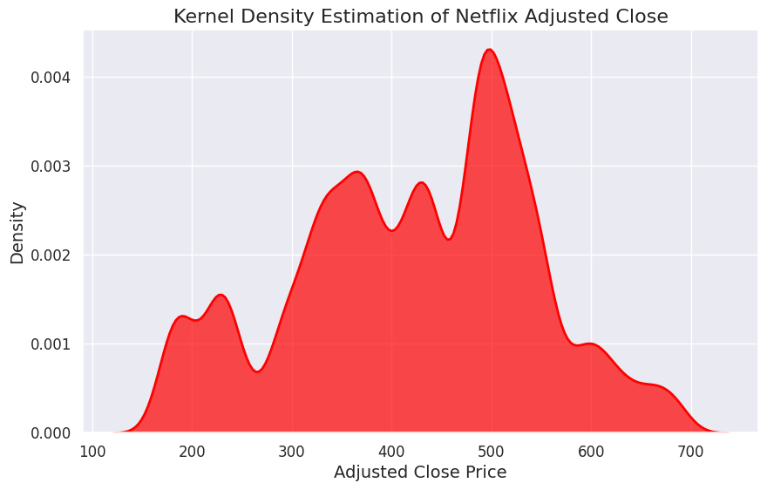
Kernel Density Estimation of Netflix Adjusted Close
Density Peaks:
Indicative of the most frequent stock price intervals
Price Distribution:
Provides a visual summary of price variability over time
Investor Insight:
Offers a glimpse into the stock’s trading density and potential investor behavior

Slide 12
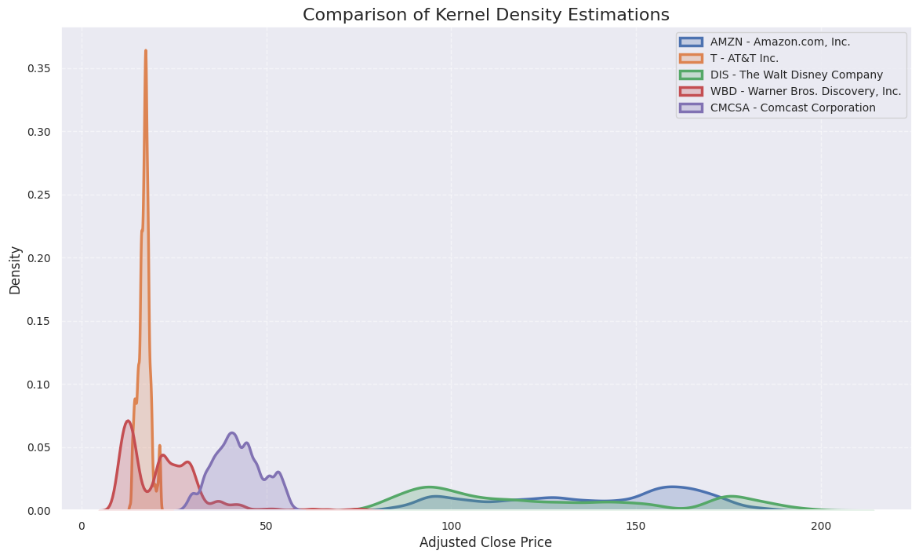
Netflix Competitor’s Kernel Density Estimation of Adjusted Close
Kernel Density Comparison:
Insight into stock price behaviors of Netflix and competitors
Volatility & Stability:
Peaks and spreads highlight market fluctuations
Strategic Insights:
Density plots reveal each firm's risk and return profile

Slide 13

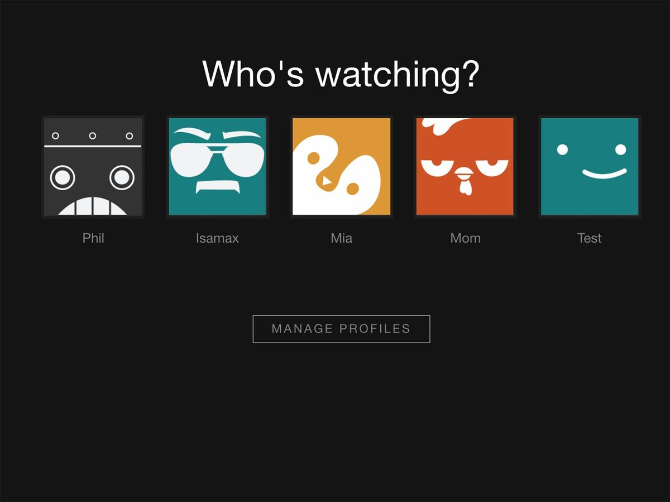

Stock Analysis: Mean, Variance, Skewness, Kurtosis
Thank you for your time and attention 🙂
Who’s Presenting?
S. No | Company | Mean | Variance | Skewness | Kurtosis
1. | AMZN | 137.55 | 280.43 | -0.30 | -1.18
2. | NFLX | 421.93 | 730.54 | -0.20 | -0.59
3. | T (AT&T) | 16.92 | 2.41 | 0.22 | 0.51
4. | DIS | 126.20 | 275.47 | 0.49 | -1.14
5. | WBD | 21.88 | 115.21 | 1.75 | 5.15
6. | CMCSA | 42.42 | 43.49 | 0.15 | -0.66
Surya
Vidhi
Soham
Sanidhya
Riya

Slide 14
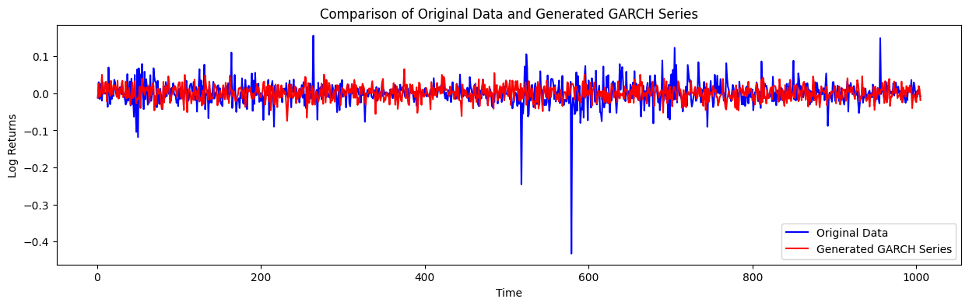
GARCH Series vs Actual Stock Price for NFLX
RMSE Value for GARCH Series – 0.0374528707372587

Slide 15
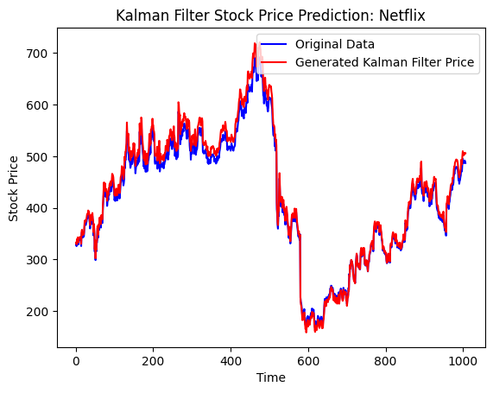
Kalman Filter Prediction vs Actual Stock Price for NFLX
RMSE Value for Kalman Filter –
$ 13.276310250240796

Slide 16
Comparing the RMSE Values from Different Models
Models | RMSE Values
Capital Asset Pricing Model | 0.02887
Augmented Autoregression | 11.50442
Fama-French 3 Factor | 9.63453
PCA | 11.75821
Factor Augmentation | 9.90311

Slide 17
Feature Sets for NFLX
Feature-set 1 | Typical Price, Typical_Price_Return
Feature-set 2 | Common Transforms
Feature-set 3 | Momentum Indicators
Feature-set 4 | Trend Indicators
Feature-set 5 | Volume Indicator
Feature-set 6 | Volatility Indicators
Feature-set 7 | ⁠Fama-French 5 Factors Indicators
Feature-set 8 | Extracting external factors using Fred API
Feature-set 9 | ADS features

Slide 18



NFLX vs Competitors
Competitors of Netflix:
Apple (AAPL)
ROKU
Paramount (PARA)
Amazon (AMZN)
The Walt Disney Co. (DIS)

Slide 19
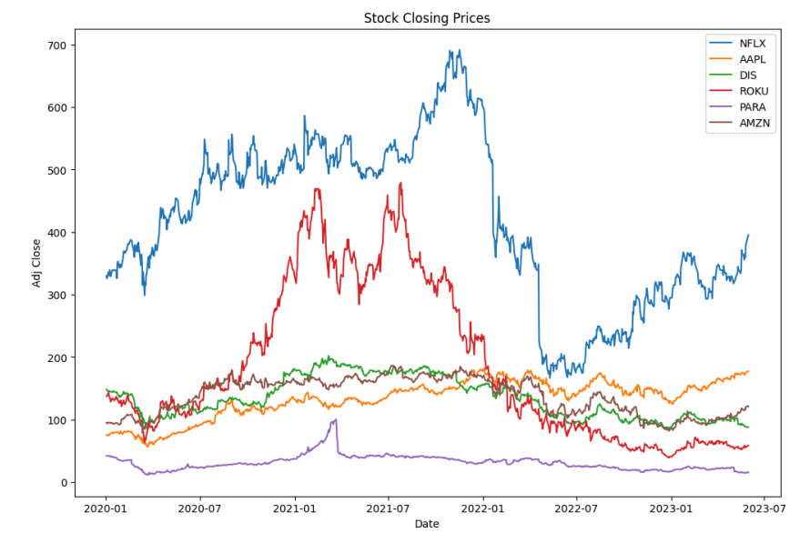
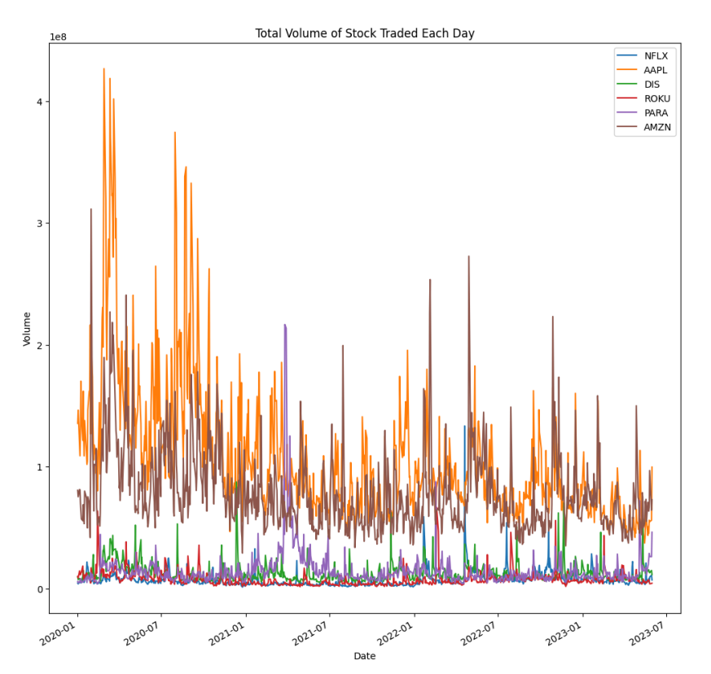
Stock Closing Prices & Total Volume NFLX vs Competitors

Slide 20
Models Preferred
- ⁠Random Forest
- Ridge Regression
- Lasso Regression
- Elastic Net Regression
- ⁠Quantile Regression
- XGBoost

Slide 21
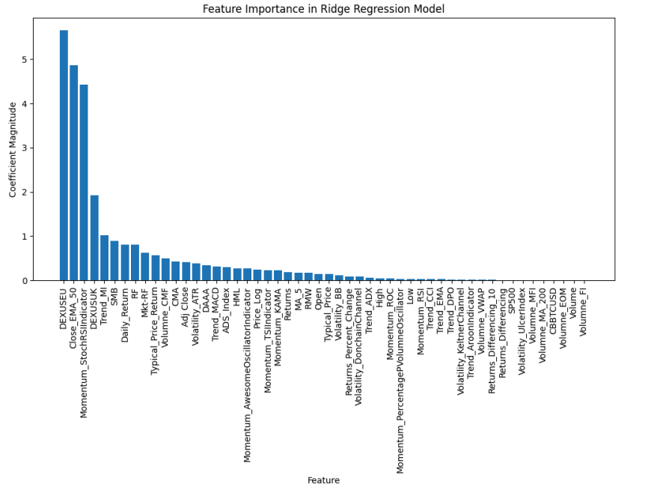
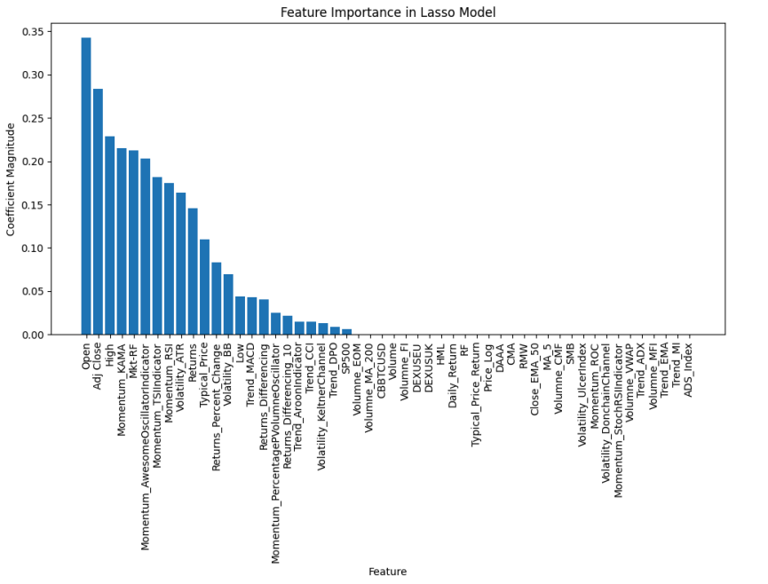
Feature Importance in Ridge and Lasso Regression

Slide 22
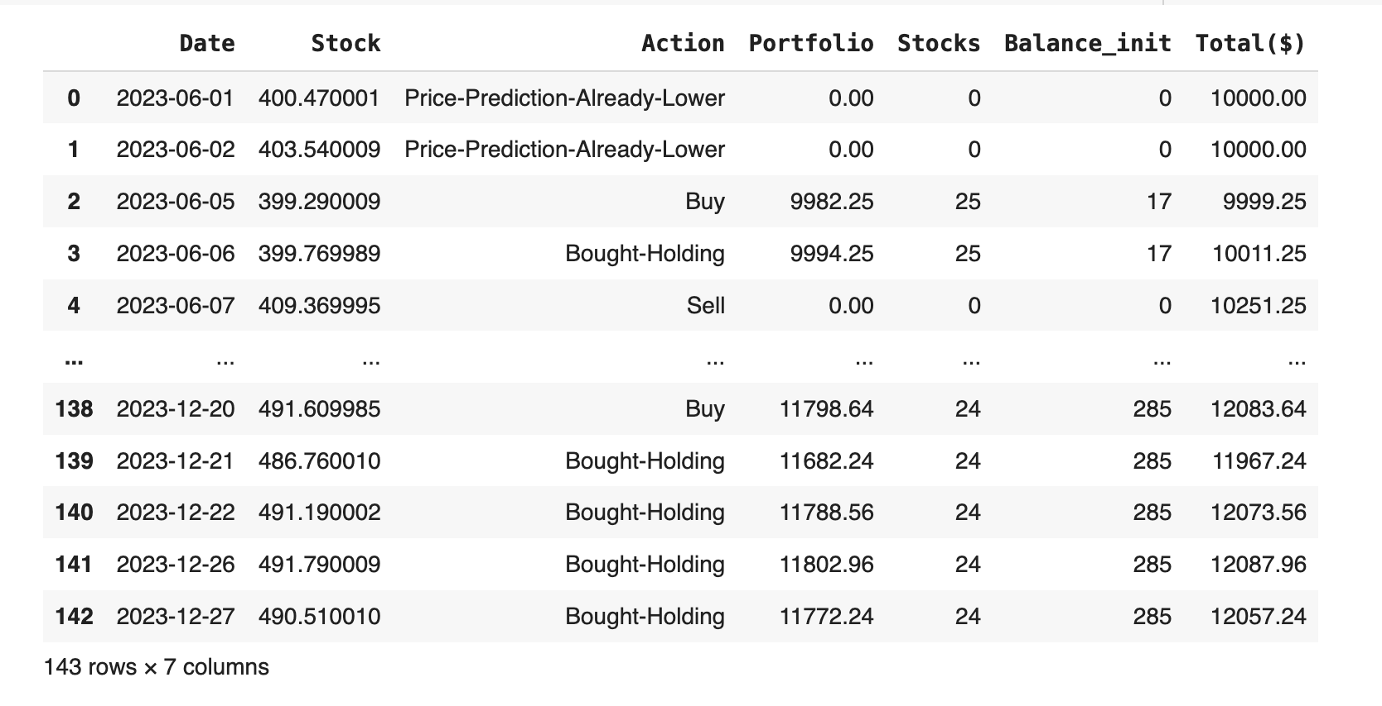
Trading Function

Slide 23

Thank you for your time and attention 🙂
Who’s Presenting?
Surya
Vidhi
Soham
Sanidhya
Riya

